Slide 1
Mashery Workshop
Part 2
Mark Mussett
mmussett@tibco.com
July 2020

Slide 2
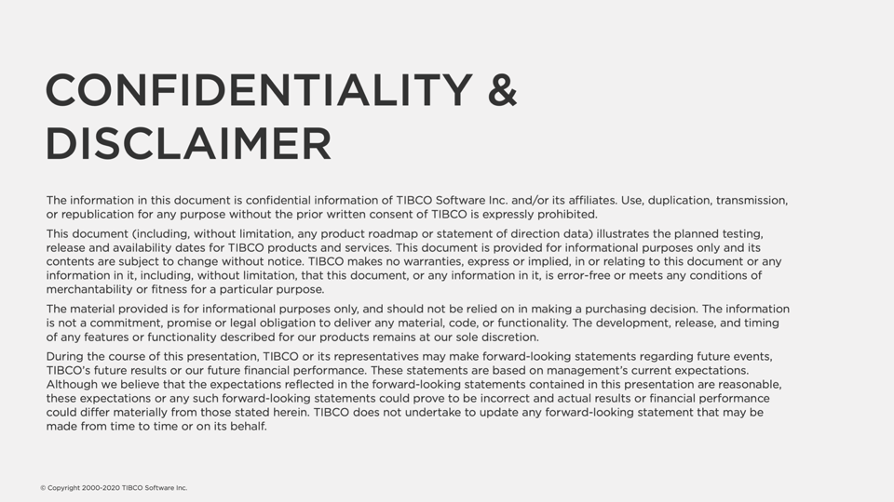

Slide 3
Agenda
Modelling & Mocking
API Documentation
Portal
OAuth 2 Accelerator
Edge Services
CI/CD
Consuming OAuth 2 Endpoint
Miscellaneous

Slide 4
Modelling & Mocking

Slide 5
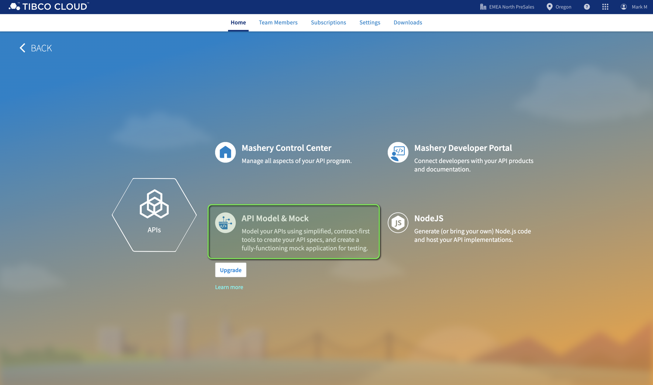

Slide 6
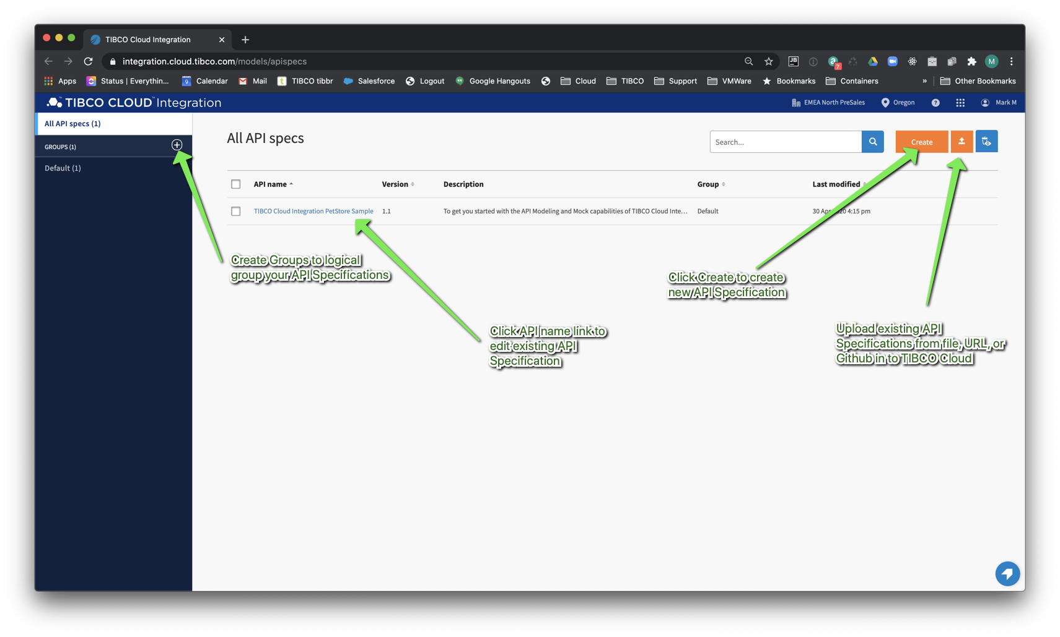

Slide 7
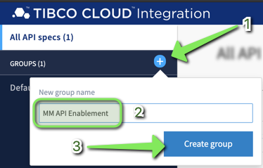
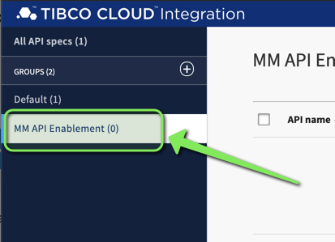
Create Group
Click “+” and create a group.
Name group “<Your Initials>” API Enablement

Slide 8
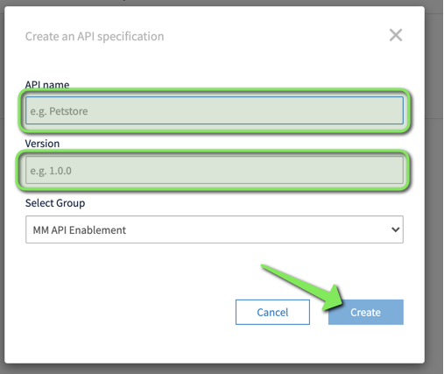
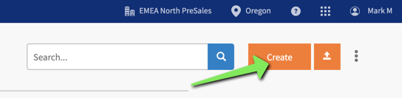
Create API specification

Slide 9
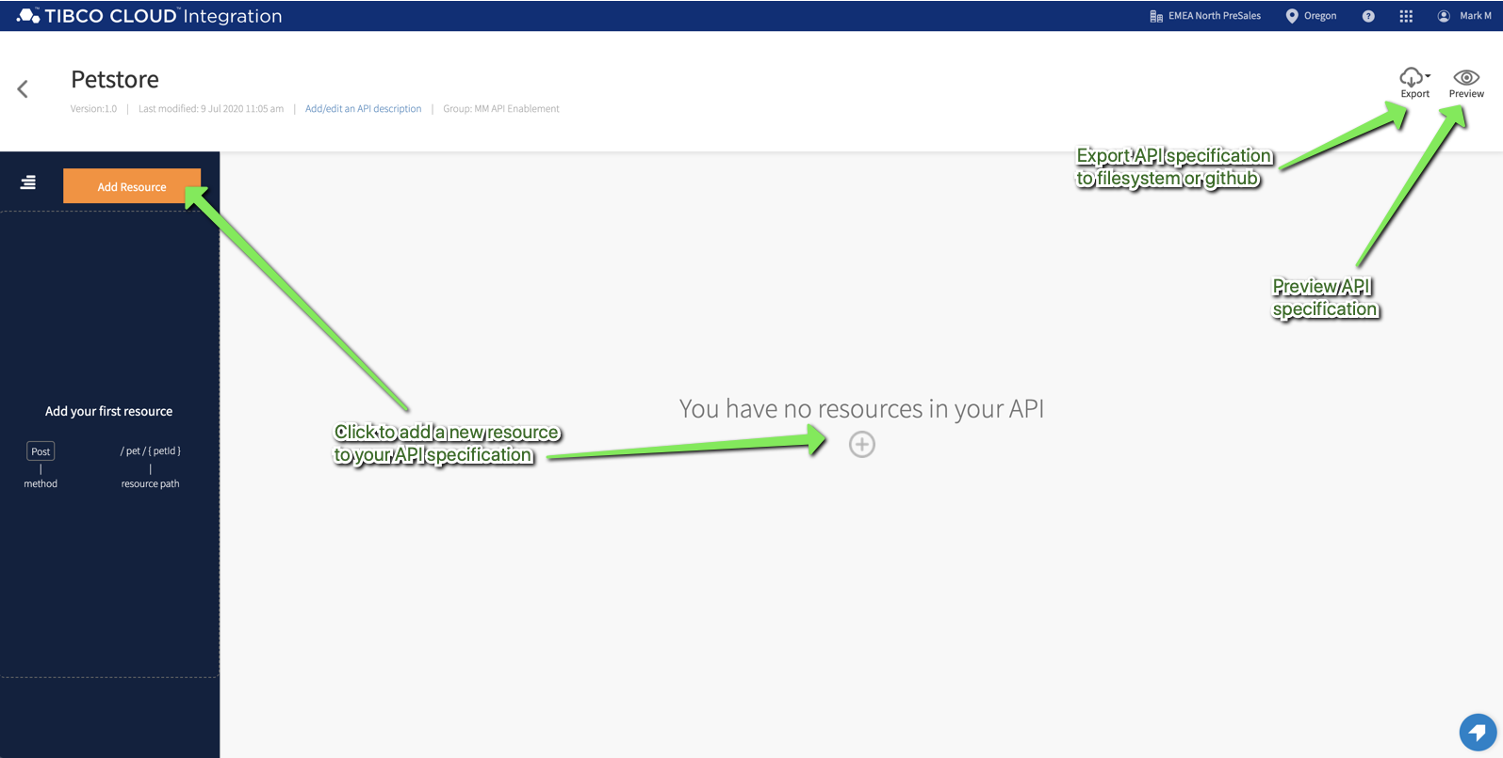

Slide 10
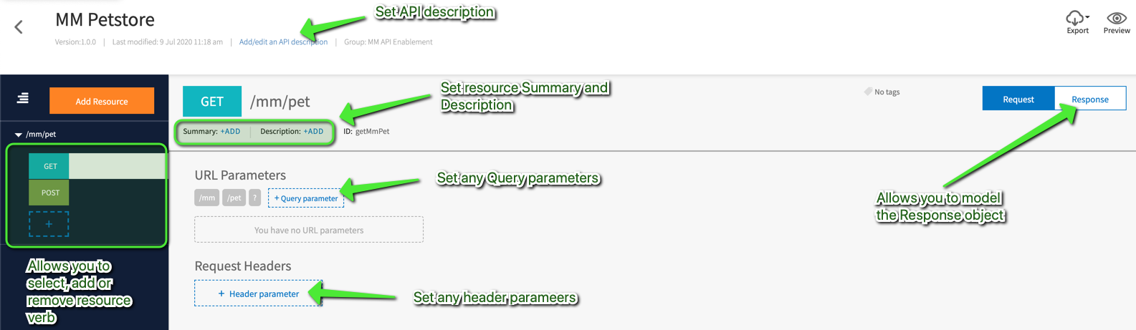

Slide 11
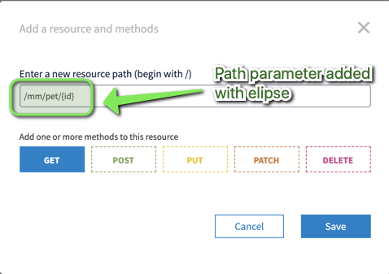
Resources with Path Parameters
Use “{param}” on resource path to signify param placeholder.

Slide 12
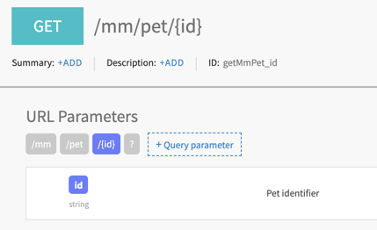
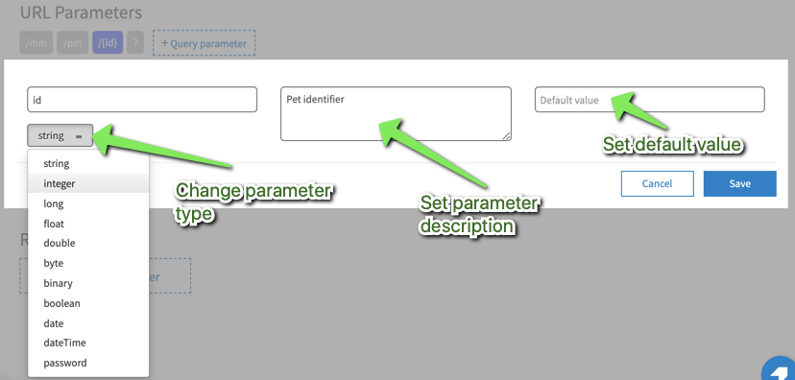
Resources with Path Parameters

Slide 13
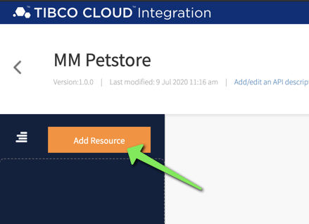
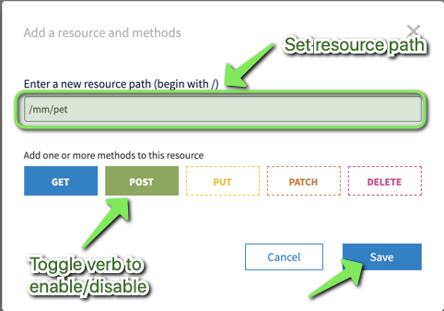
Add resource to API specification
Add Resource path /pet/{id} and toggle GET method

Slide 14
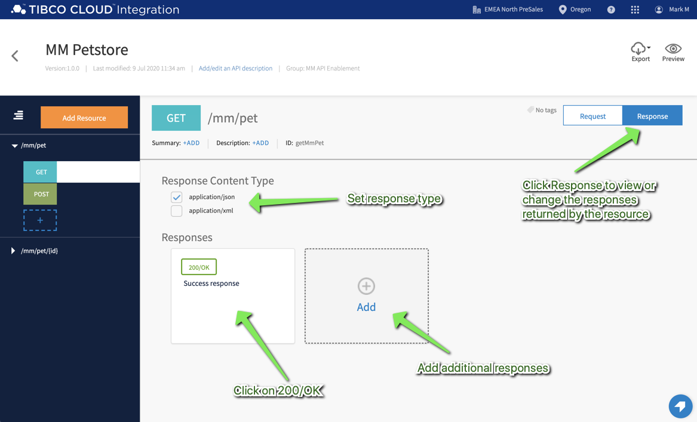
Modelling Responses

Slide 15
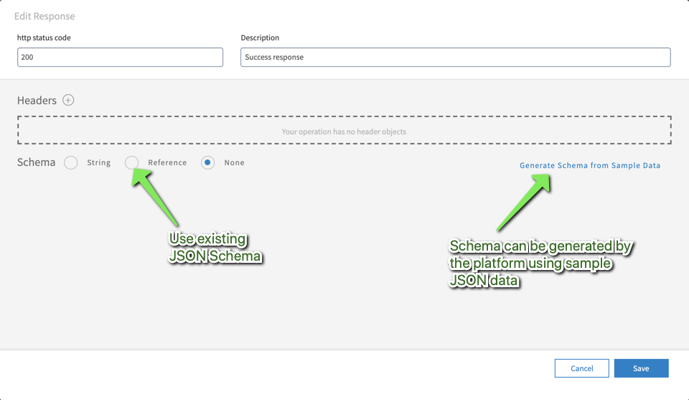
Modelling Response

Slide 16
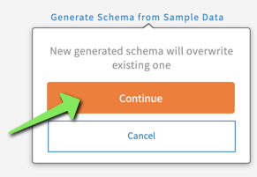
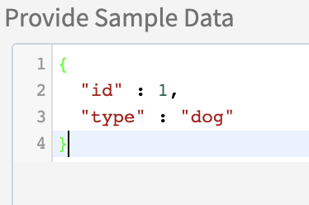
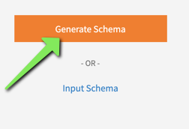
Create JSON Schema from sample JSON
Add response to 200/OK using sample JSON.

Slide 17
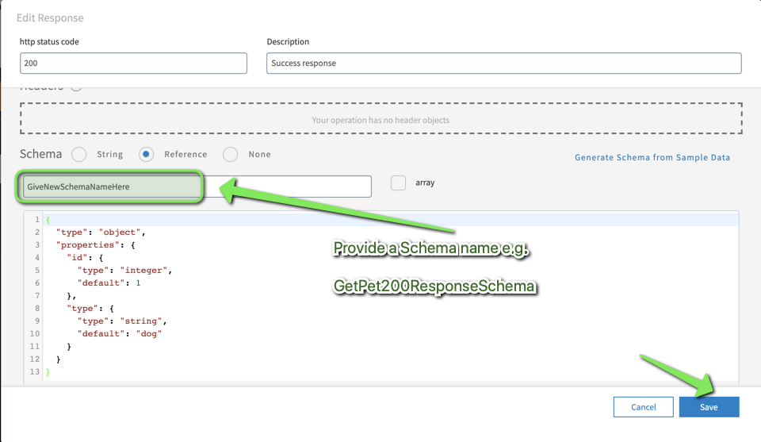
Create JSON Schema from sample JSON

Slide 18
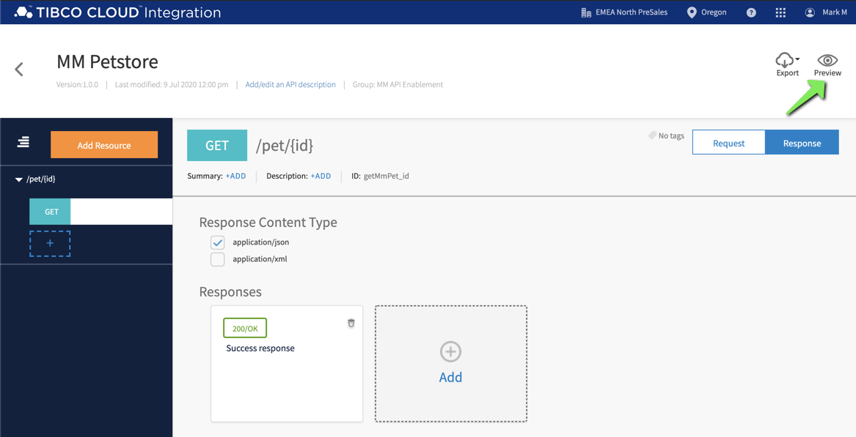
Preview your API specification

Slide 19
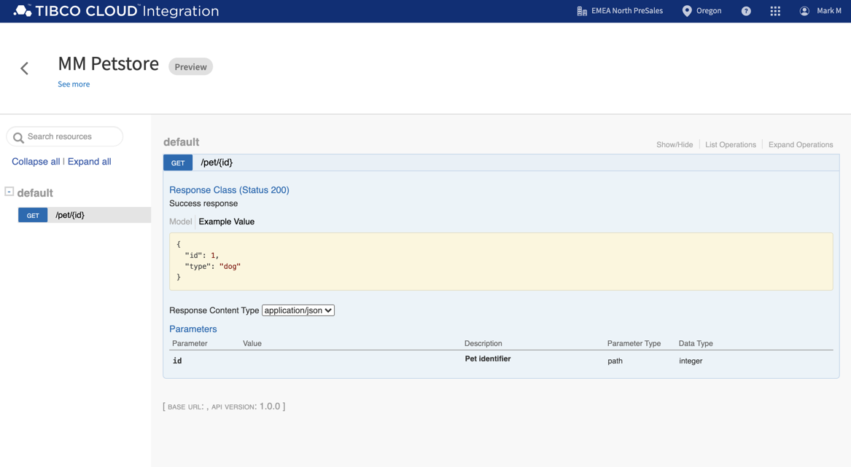
Preview your API specification

Slide 20
Bonus - Model a Not Found Response
Add an appropriate response for not found.

Slide 21
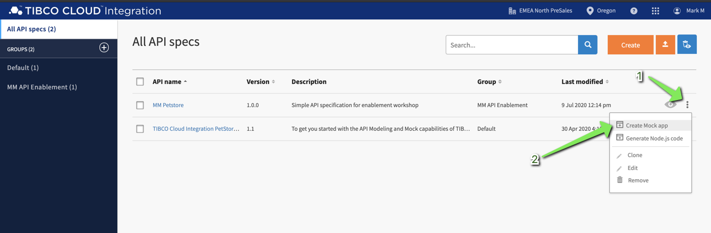
Creating Mock Application
Single click to turn any API specification into a Mock Application

Slide 22
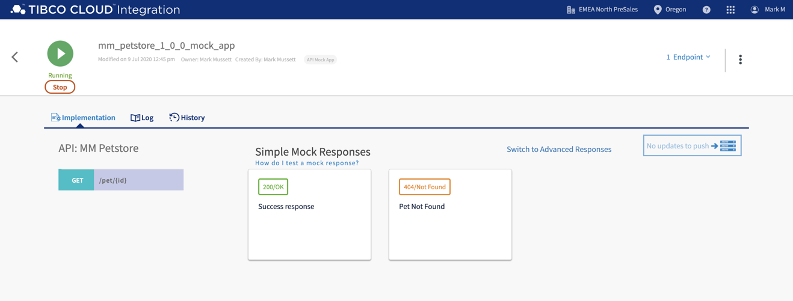
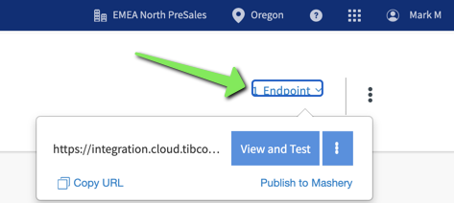
Creating Mock Application

Slide 23

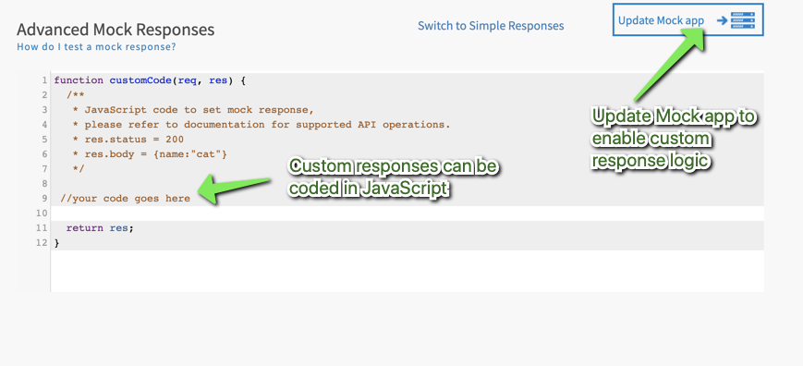
Customizing Mock responses
function customCode(req, res) {
var pathparams = req.params;
if (pathparams.id === '1') {
res.status = 200;
res.body = {
id: 1,
type: 'cat'
};
}
else if (pathparams.id === '2') {
res.status = 200;
res.body = {
id: 2,
type: 'dog'
};
} else {
res.status = 404;
}
return res;
}

Slide 24
Creating Mock Application
Convert your API specification to a Mock application.
Export your Mock Application specification.

Slide 25
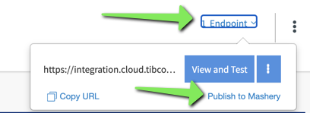
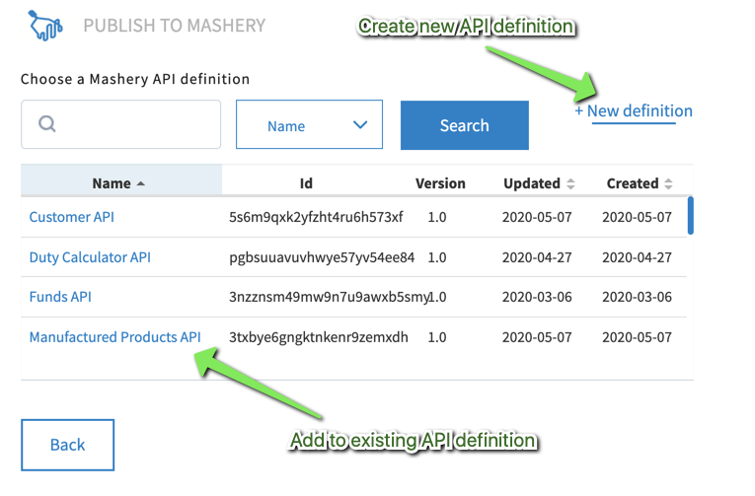
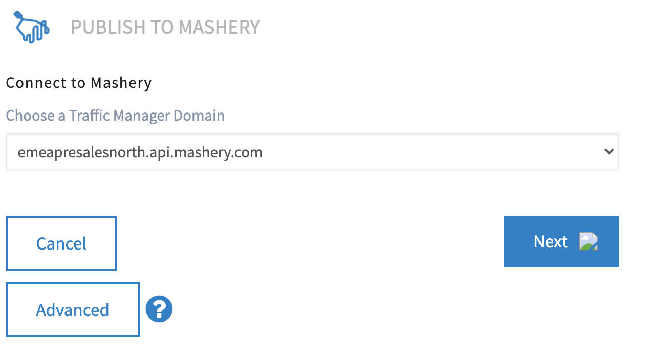
Publishing Mock to Mashery

Slide 26
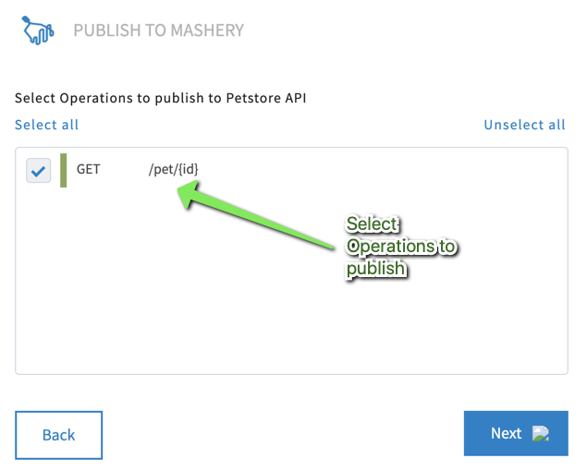
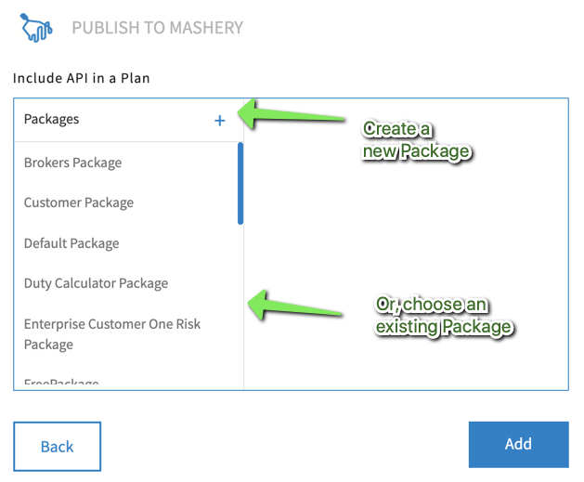
Publishing Mock to Mashery

Slide 27
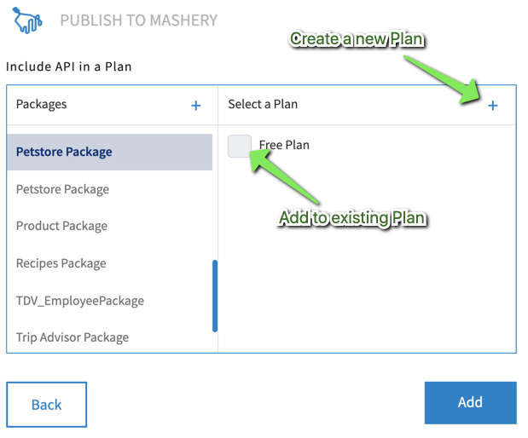
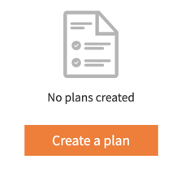
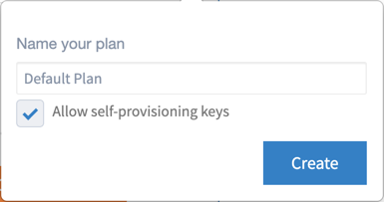
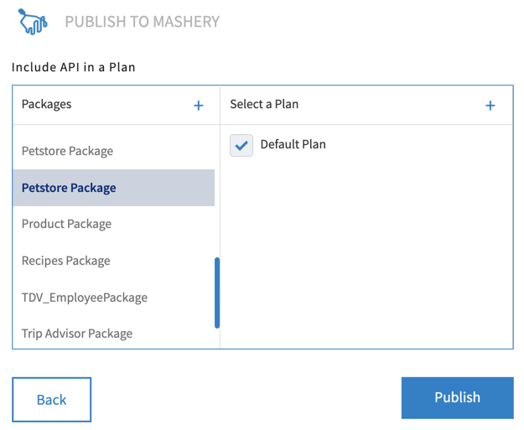
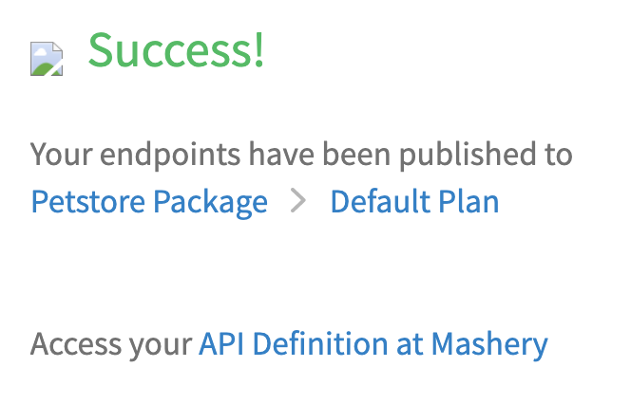
Publishing Mock to Mashery
No Plan…

Slide 28
Publishing Mock to Mashery
Publish your Mock Application to Mashery.
Create a new API definition ‘<initials> Petstore API’
Create a new Package ‘Petstore Package’
Create a new Plan ‘Default Plan’
Login to Mashery Control Centre and change:
API Endpoint name to ‘Pet v1’
API Endpoint Public Protocol to Https
API Endpoint Public path to /<initials>/v1/pet/{id}
API Endpoint enable CORS
API Endpoint API Key in Header

Slide 29
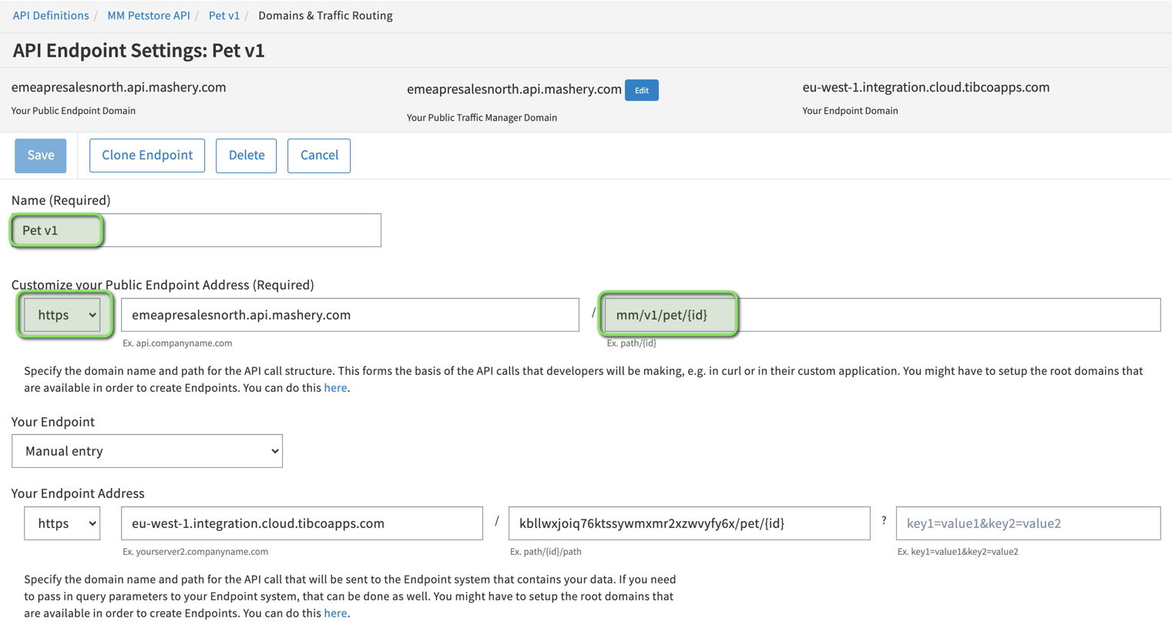

Slide 30
API Documentation

Slide 31
Documentation
Interactive Documentation
Ability to provide UI to API consumers to quickly test an API and gather results
Hosting of IO-Docs or Swagger format
Static Documentation
Hosting content within the Platform
Support for HTML or Mark Down

Slide 32
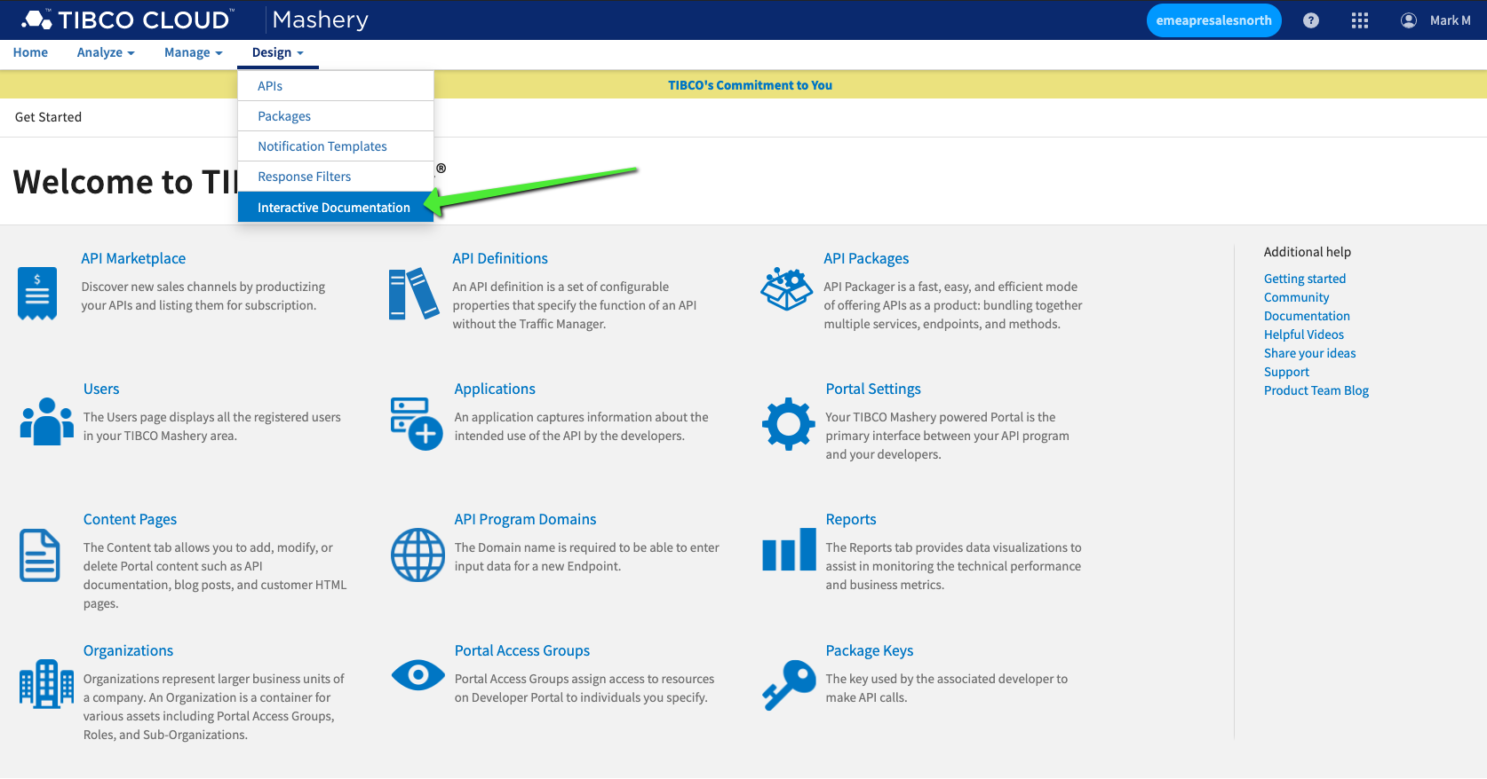
Create Interactive Documents

Slide 33
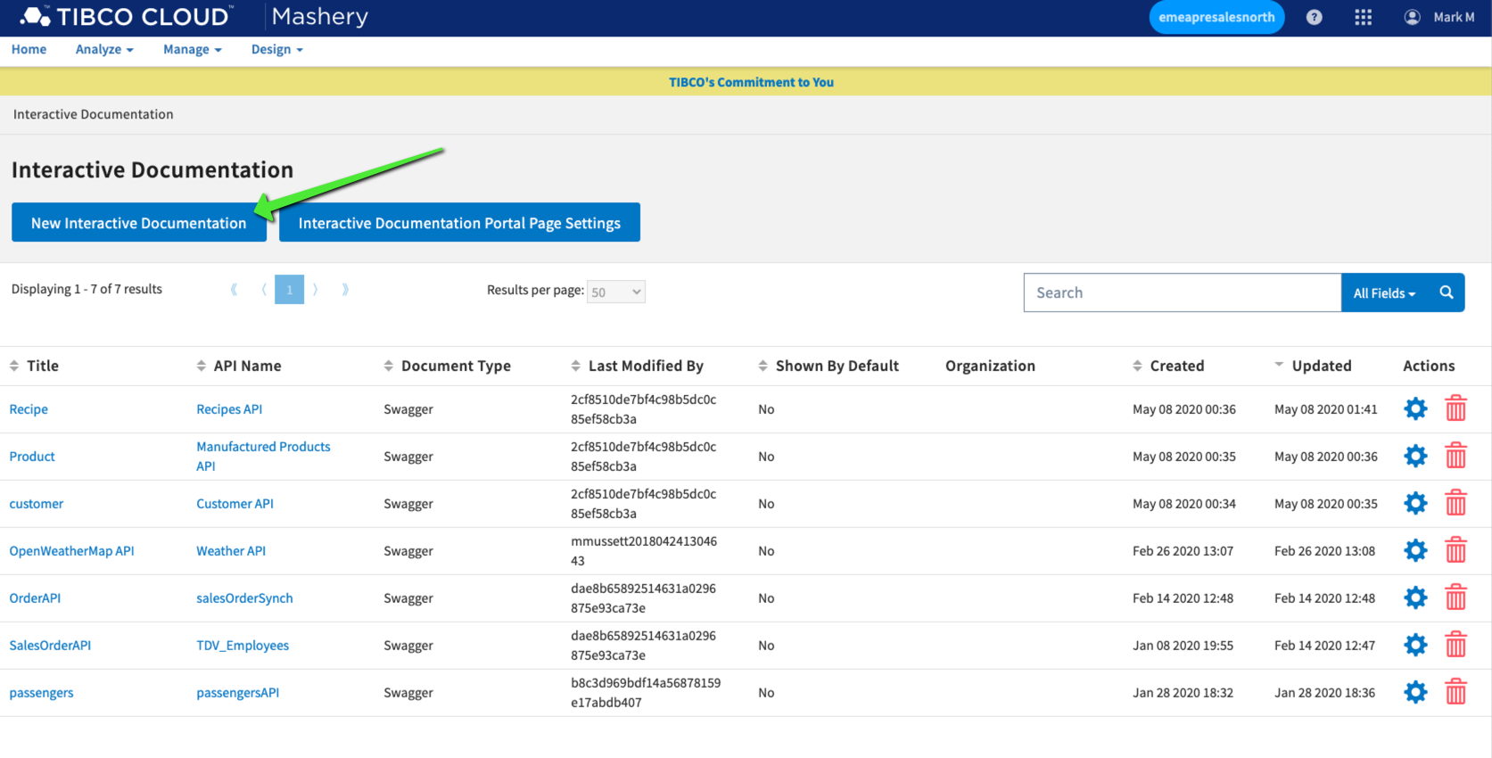
Create Interactive Documents

Slide 34
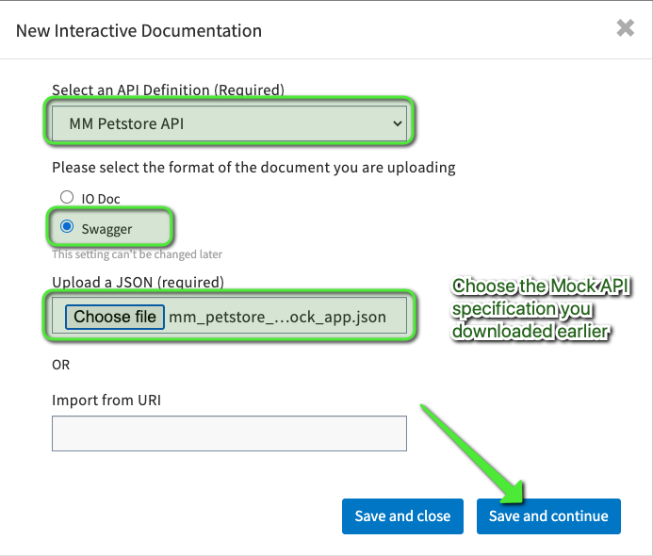
Create Interactive Documents

Slide 35
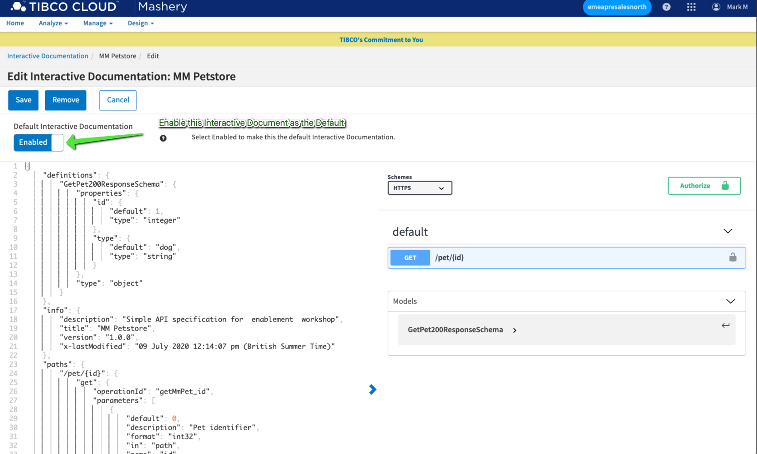
Create Interactive Documents

Slide 36
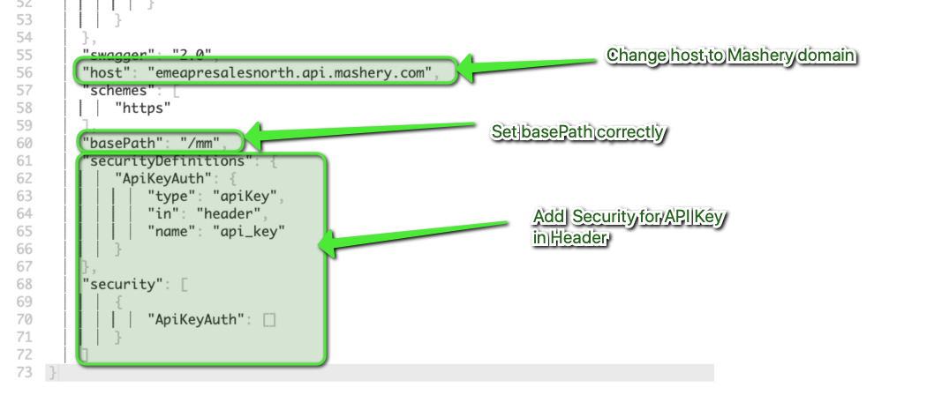
Create Interactive Documents

Slide 37
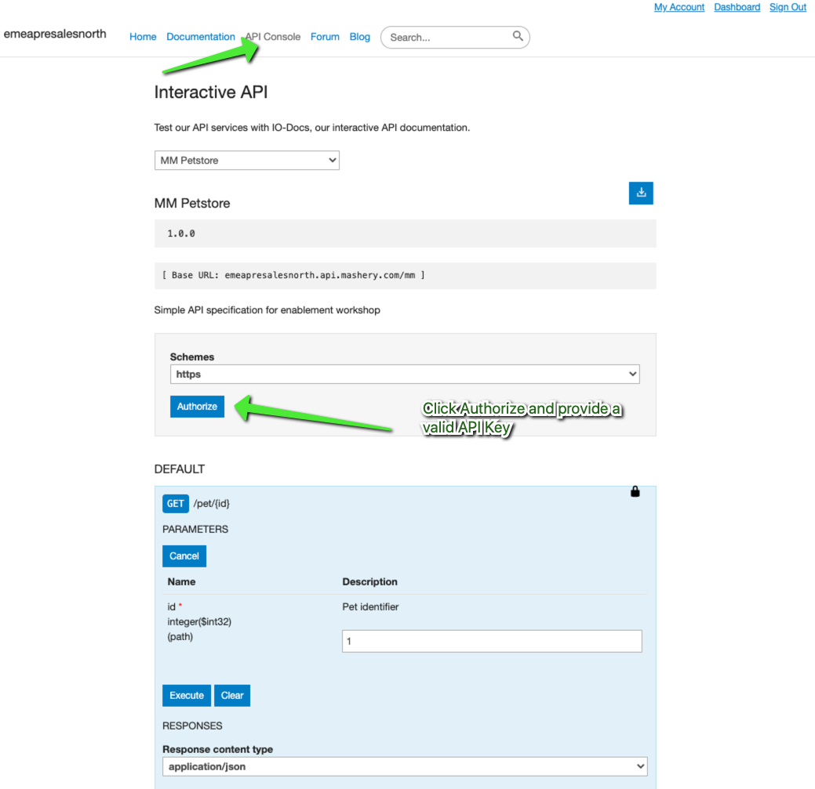
Using Interactive Documents

Slide 38
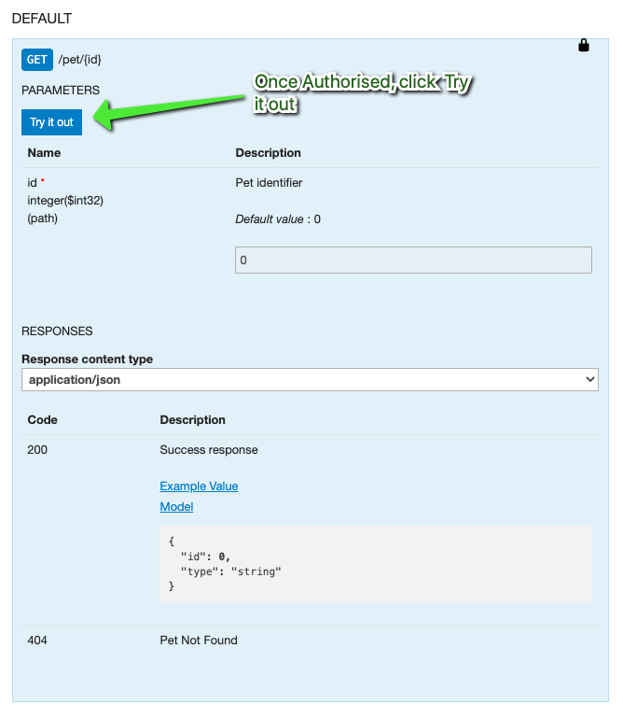
Using Interactive Documents

Slide 39
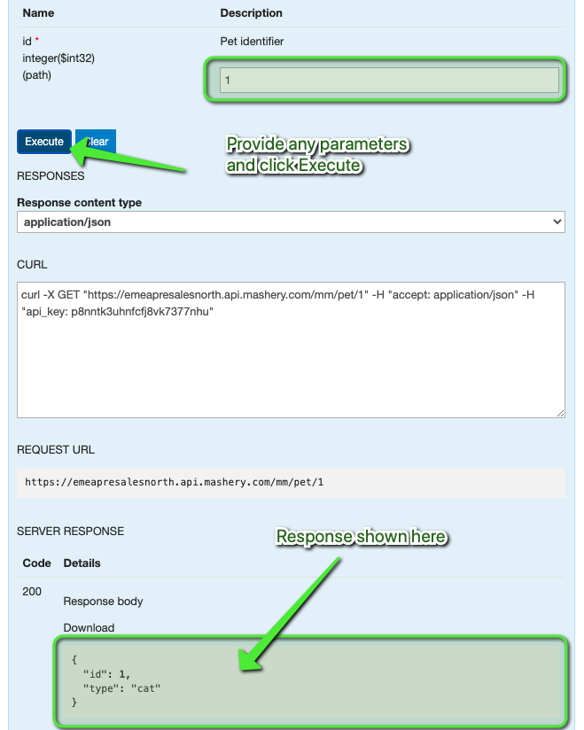
Using Interactive Documents

Slide 40
Static Documentation
Documentation and other content can be hosted by Mashery Portal.
Ability to upload and host any content and then link to it via the documentation pages
Support for HTTP, Github-Flavoured Markdown and BetterDocs formats
Simple WYSIWG HTML Editor called TinyMCE
Can be switched off to edit in text mode.
Document pages are indexed and searchable

Slide 41
Portal

Slide 42
Customising the Portal
Portal can be re-skinned by either Mashery UI team or by customer
Portal is a combination of HTLM + CSS + Javascript
A set of template starter kits are available here
Documentation steps for installing start kits online
Setting up customised portal requires mashery team to enable customisation feature on portal
Raise ticket to have this enabled.

Slide 43
OAuth 2

Slide 44
General FYI
Support for OAuth 2 requires customers having paid for OAuth 2.0 Accelerator feature.
Redirection URL Check – Mashery does not perform any check against the supplied redirect_uri.
Mashery does not perform any scope checking.
Foreign authorization codes, access or refresh tokens cannot be imported into Mashery. Mashery must always generate these.
Client Credentials must be generated for each API consumed.

Slide 45
Supported Grants Types
Authorization Code
Implicit Grant
Resource Owner Password Credential
Client Credential

Slide 46
Authorization Code Flow
Customer must provide Authorization Server

Slide 47
Implicit Grant Flow
Customer must provide Authorization Server

Slide 48
Resource Owner Password Credential Grant Flow
Customer must provide Authorization Server

Slide 49
Client Credential Grant Flow

Slide 50
Setting up API for OAuth 2 – Client Credentials Grant Type

Slide 51
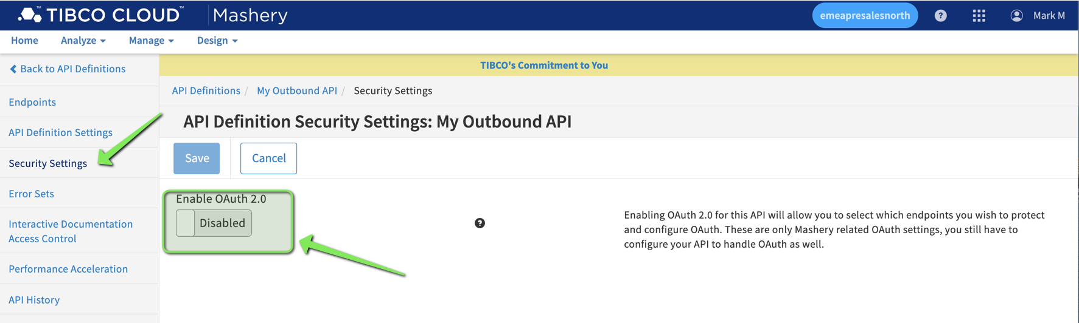
Setting up API for OAuth 2 – Client Credentials Grant Type
Enabled via API Definition Menu -> Security Settings…

Slide 52
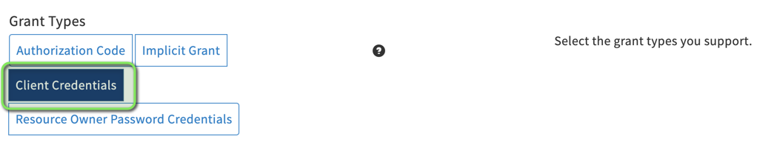
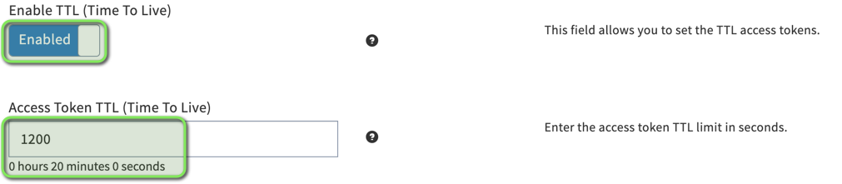
Setting up API for OAuth 2 – Client Credentials Grant Type
Toggle Grant Type
Set TTL for Access Token

Slide 53
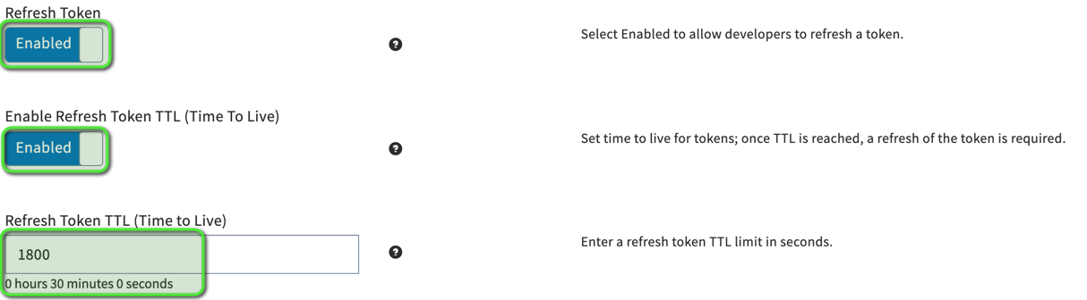
Setting up API for OAuth 2 – Client Credentials Grant Type
Set Refresh Token TTL

Slide 54
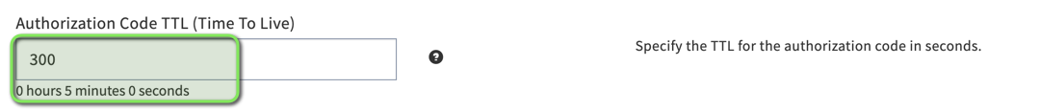
Setting up API for OAuth 2 – Client Credentials Grant Type
Enable Mashery Token API
Enable all Forwarded Headers
Set Authorization Code TTL

Slide 55

Add Token Endpoint

Slide 56

Configure Token Endpoint

Slide 57


Slide 58

Configure Resource Authentication
On your Resource Endpoint, switch Request Authentication Type from API Key to OAuth2.0

Slide 59

Configure Resource Authentication
On Key & Method Detection Menu, switch Request Authentication Type from “API Key” to “OAuth 2.0”
Set OAuth Grant Types to Client Credentials

Slide 60

Add Token Endpoint to your Package & Plan

Slide 61

Enable Shared Secret on your Package Key Properties

Slide 62

Create a new Package Key with Shared Secret
You can generate a new Package Key for your existing Application via Manage->Application->Package Keys->New Package Key

Slide 63

Enable API Key

Slide 64

Testing with Postman

Slide 65


Testing with Postman

Slide 66

Testing with Postman

Slide 67


Slide 68
Data Filtering

Slide 70
CI/CD

Slide 71
Platform APIs
Platform APIs provide a way to integrate with 3rd party CI/CD tools such as Jenkins in order to automate tasks.
Comprehensive Postman collection located at:
https://documenter.getpostman.com/view/4885521/RzfcKqGJ?version=latest
Use Postman & Newman to automate platform call sequence
Platform APIs docs
https://developer.mashery.com/

Slide 72
Other 3rd Party Mashery Tools
These tools are not support by TIBCO
Mashcli
https://github.com/mmussett/mashcli
Developed and supported by mmussett@tibco.com
Mashery Toolbelt
https://github.com/mmussett/mashery-toolbelt
Written by Adidas but repository archived and no longer supported.

Slide 73
Edge Services

Slide 74
Edge Services
TIBCO Cloud Integration Developer (Flogo) component can be used to support Backend-For-Frontend (BFF) Pattern or Experience APIs
Useful for orchestrating multiple downstream service calls and aggregating results before delivering response:

Slide 75
Consuming OAuth 2 Endpoint

Slide 76
Options :-
Expose Oauth 2.0 token endpoint using Mashery and modify client code to make OAuth2 token call.
Use Flogo Application to orchestrate OAuth2 token and API endpoint call.
Develop a custom adapter – requires Mashery CS to implemented for Mashery Cloud, SDK available for Mashery Local deployment

Slide 77


Slide 78
Miscellaneous

Slide 79


Adding HTTP Headers
Static HTTP Headers can be injected on both outbound and inbound traffic flows.

Slide 80


Removing HTTP Headers
HTTP Headers can be removed on both outbound and inbound traffic flows.

Slide 81


API Key Credential Swapping
API Endpoint -> More Settings -> Swap Incoming API credentials for Mashery Credentials.

Slide 82


API Key Credential Swapping – Parameter to Header
API Endpoints -> Key & Method Detection -> Developer’s API Key Location - Parameters.
API Endpoints -> More Settings -> Remove API Key and Signature Query Parameters from Backend Call – Enabled

Slide 83


API Key Credential Swapping – Parameter to Header
API Endpoints -> Call Transformations -> Processing Adapter - com.mashery.proxy.core.add-headers-processor

Slide 84

API Key Credential Swapping – Header to Parameter
API Endpoints -> Key & Method Detection -> Developer’s API Key Location - Header.

Slide 85

API Key Credential Swapping – Parameter to Header
API Endpoints -> Call Transformations -> Processing Adapter - Mashery_Proxy_Processor_StripHeaders

Slide 86

API Key Credential Swapping – Parameter to Header
API Endpoints -> Domains & Traffic Routing -> Your Endpoint Address -> Parameters

Slide 87

API Key Credential Swapping – Parameter to Header

